Slide 1
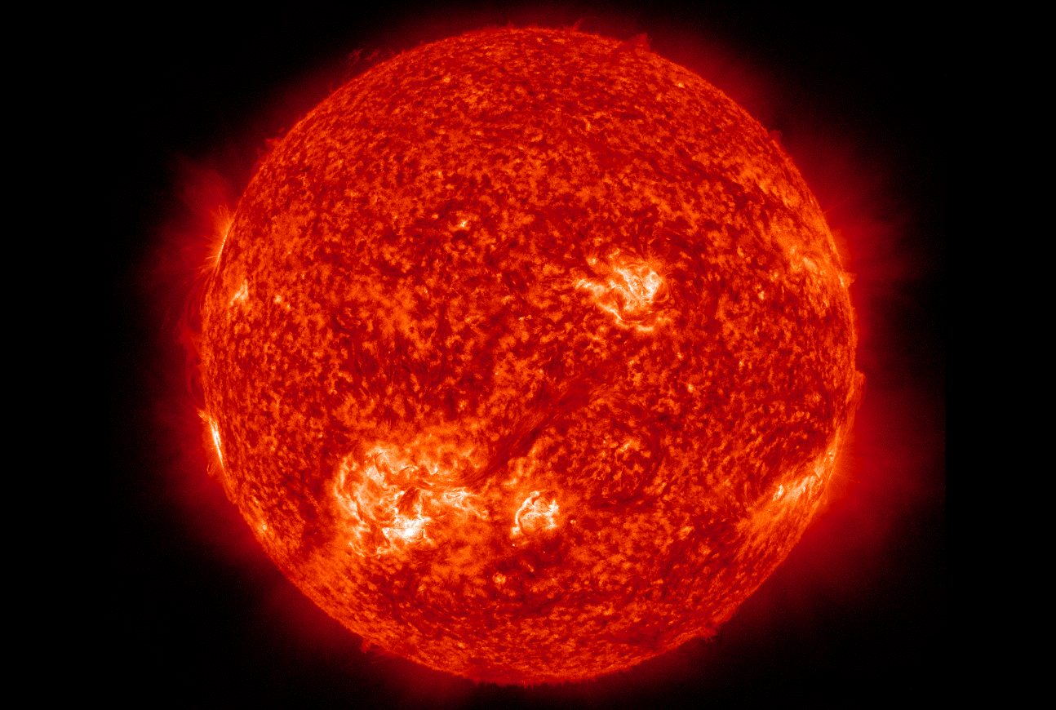
Stellar Evolution Simulator
Reese Danzer and Karthik Boyareddygari

Slide 2
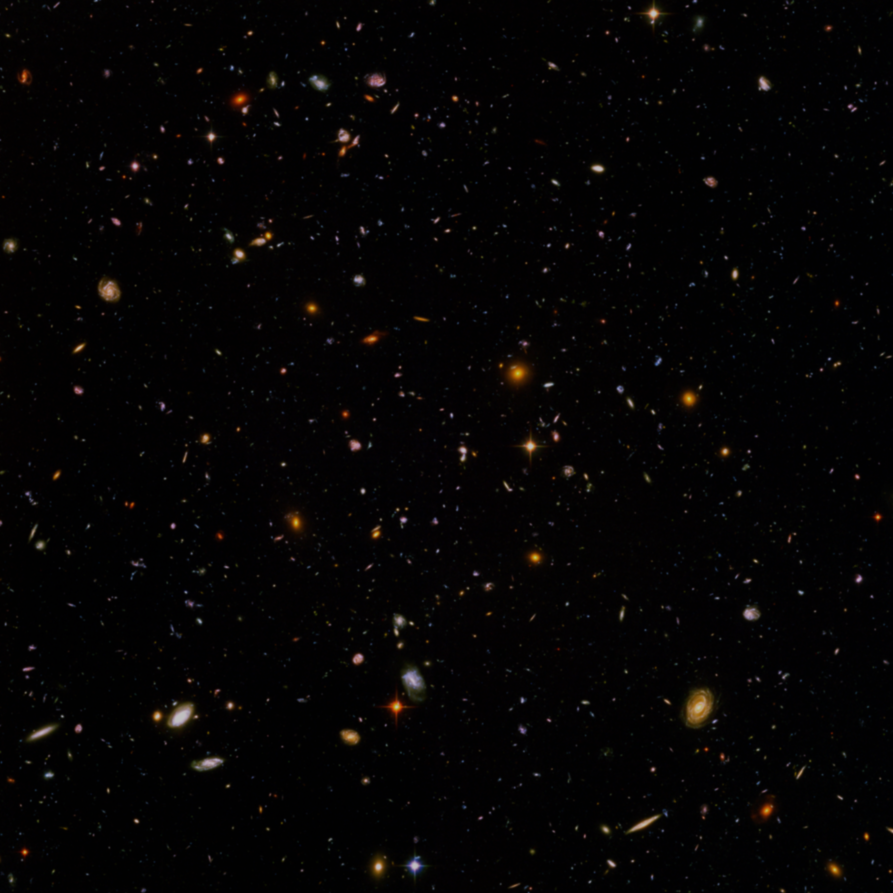
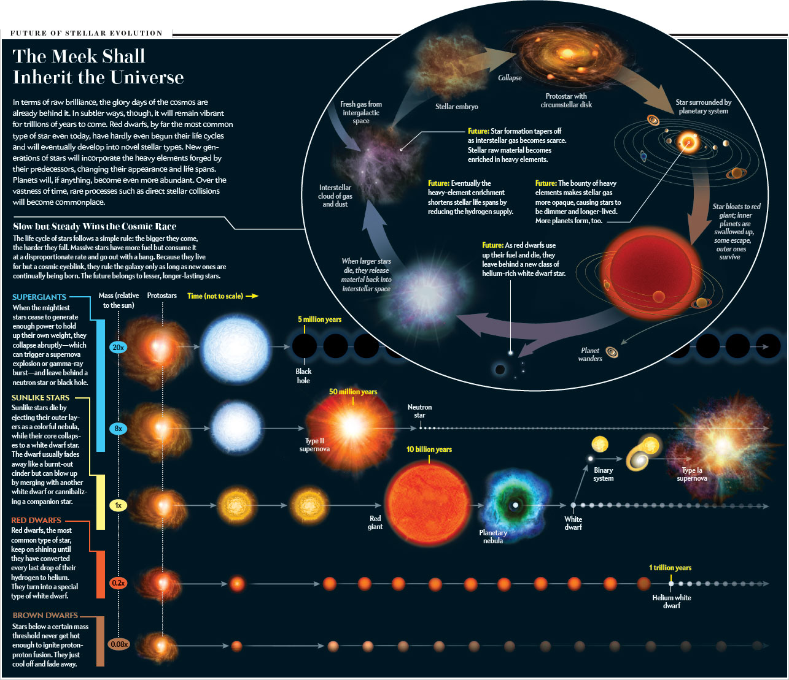
What We Attempted to Model
Stars are extremely complex and variable systems. The starting mass of a star has an enormous effect on what happens in that star’s life, how long it lives, and how it dies and what it’s final state is. Everything that happens in a single, isolated stellar lifetime can be predicted from the starting mass of the star in question. We sought to create a visual representation of a stellar life in Mathematica, based on just a single input mass.
Source: http://www.nature.com/scientificamerican/journal/v306/n3/box/scientificamerican0312-32_BX2.html

Slide 3
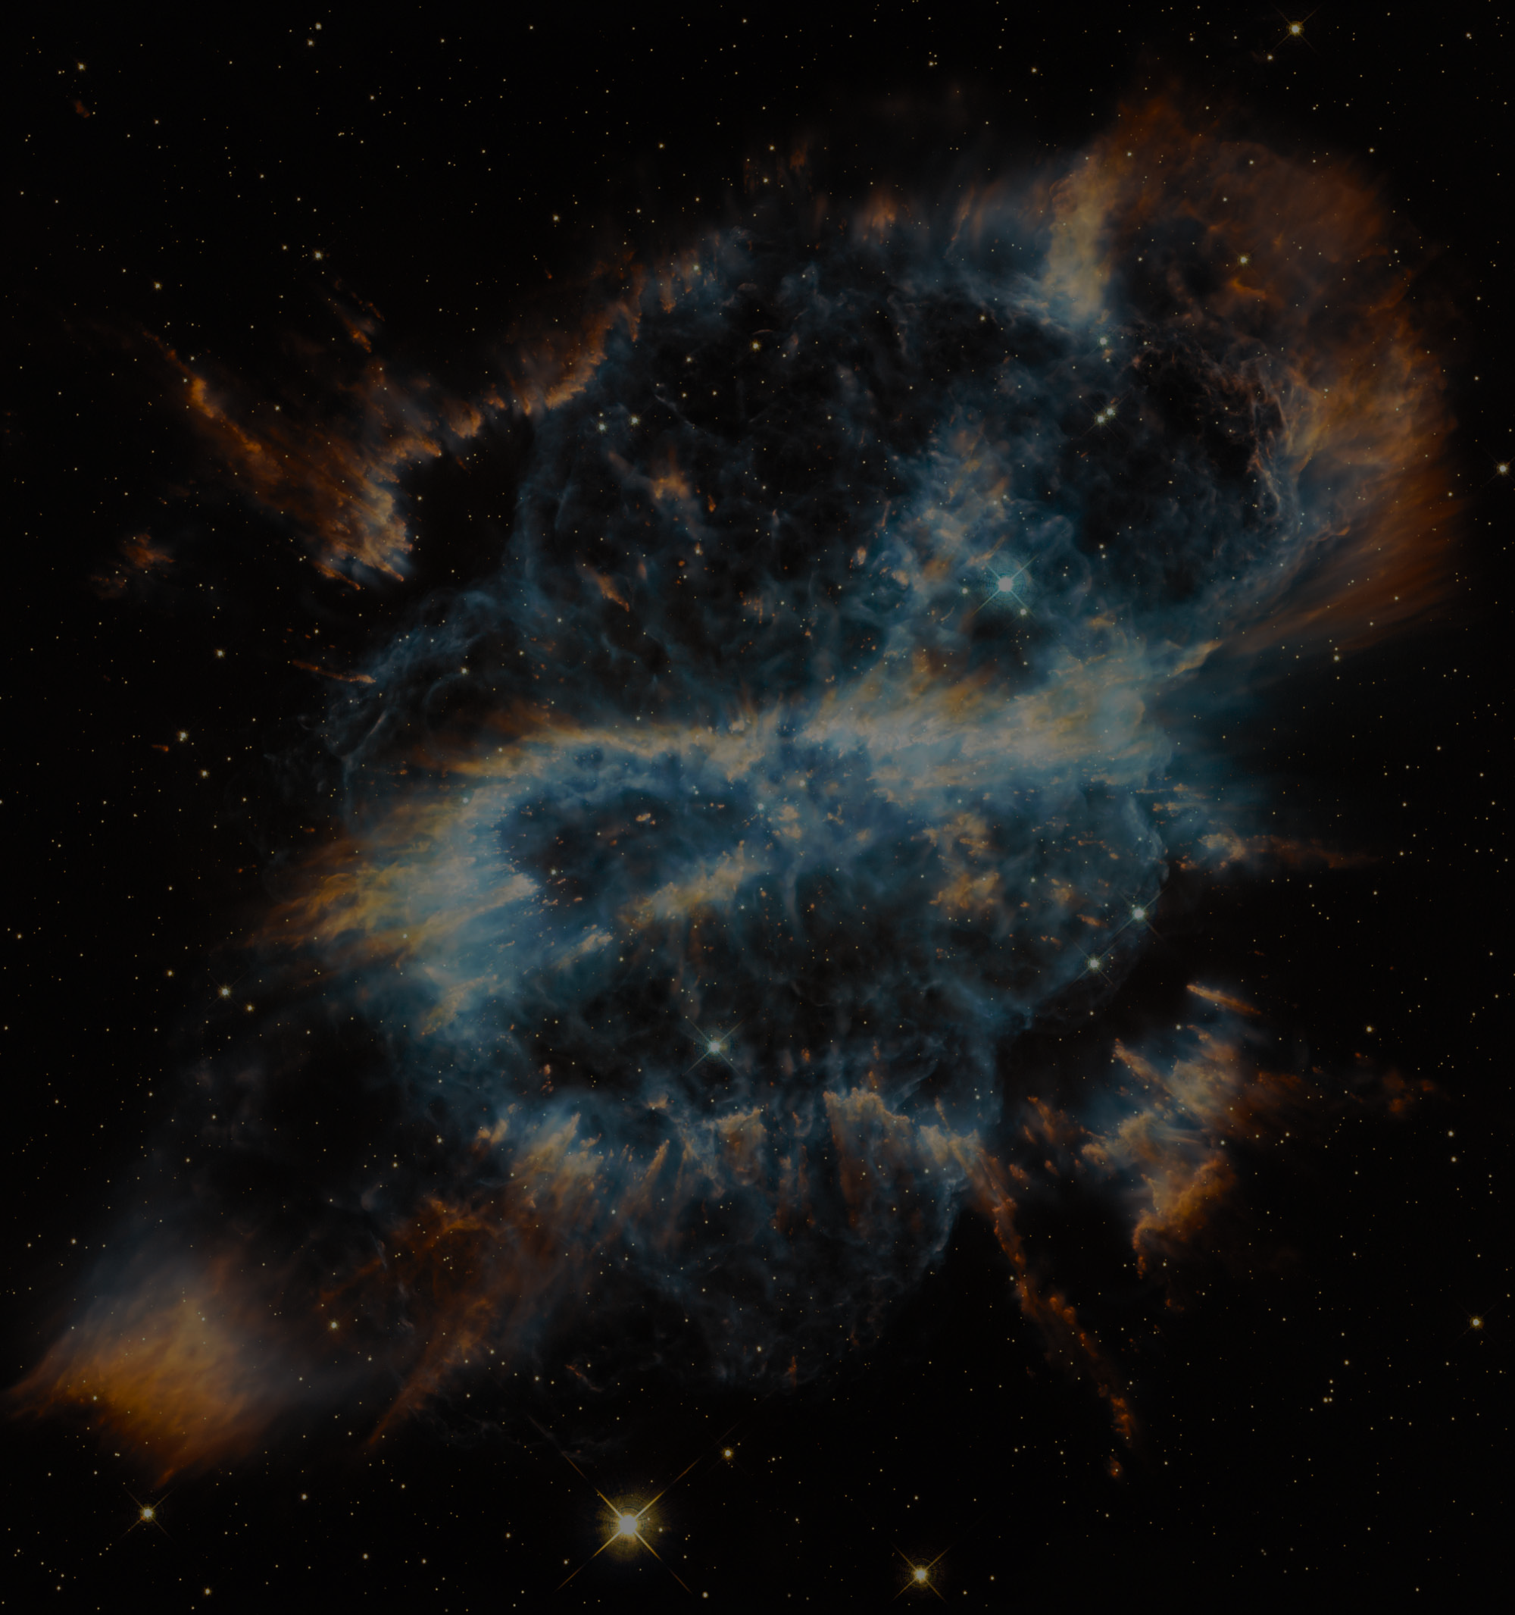
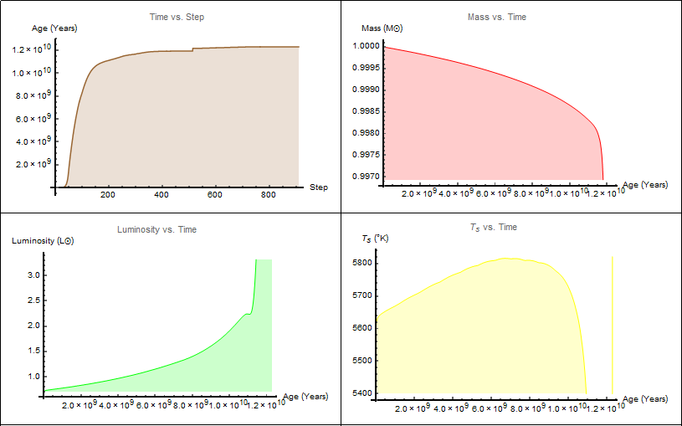
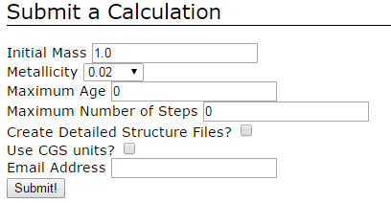
How We Did It/EZ-Web
The mathematics behind stellar evolution consists of extremely complex higher-order iterative partial differential equations, and is still a subject of debate amongst astrophysicists today.
On the advice of our amazing mentor Dr. Carini, we took a database approach instead of programming in the actual math. This was a good choice, as it allowed us to focus more on other aspects of our code, such as the UI and event functions.
The program we used to populate our database is called EZ-Web. It’s a stellar evolution code that takes input parameters and generates a series of text files detailing characteristics of the star at certain points in time.
We use those text files to construct a database, and pull necessary data from that database each time our program is executed. We then use Mathematica’s built in commands to create interpolated functions, and use those functions in our visual.

